Slide 1
Concurrency Control

Slide 2
Concurrency Control
A database must provide a mechanism that will ensure that all possible schedules are
serializable, and
are recoverable and preferably cascadeless
Testing a schedule for serializability after it has executed is a little too late!
Goal – to develop concurrency control protocols that will assure serializability

Slide 3
Concurrency Control vs. Serializability Tests
Concurrency control protocols generally do not examine the precedence graph as it is being created
Instead, a protocol imposes a discipline that avoids nonseralizable schedules.
Different concurrency control protocols provide different tradeoffs between the amount of concurrency they allow and the amount of overhead that they incur

Slide 4
Enforcing serializability
Tests for serializability help us understand why a concurrency control protocol is correct
Knowing how to recognize conflict serializability is not enough. We will now study mechanisms that enforce serializability:
Locking (pessimistic concurrency control).
Time stamping (optimistic concurrency control).

Slide 5
Intuition of Lock-based Protocols
Transactions have to acquire locks on data items before accessing them.
If a lock is hold by one transaction on a data item this restricts the ability of other transactions to acquire locks for that data item
By locking a data item, we want to ensure that no access to that data item is possible that would lead to non-serializable schedules

Slide 6
Intuition of Lock-based Protocols
Lock-based concurrency protocols are a form of pessimistic concurrency control mechanism
We avoid ever getting into a state that can lead to a non-serializable schedule
Alternative concurrency control mechanism do not avoid conflicts, but determine later on (at commit time) whether committing a transaction would cause a non-serializable schedule to be generated
Optimistic concurrency control mechanism

Slide 7

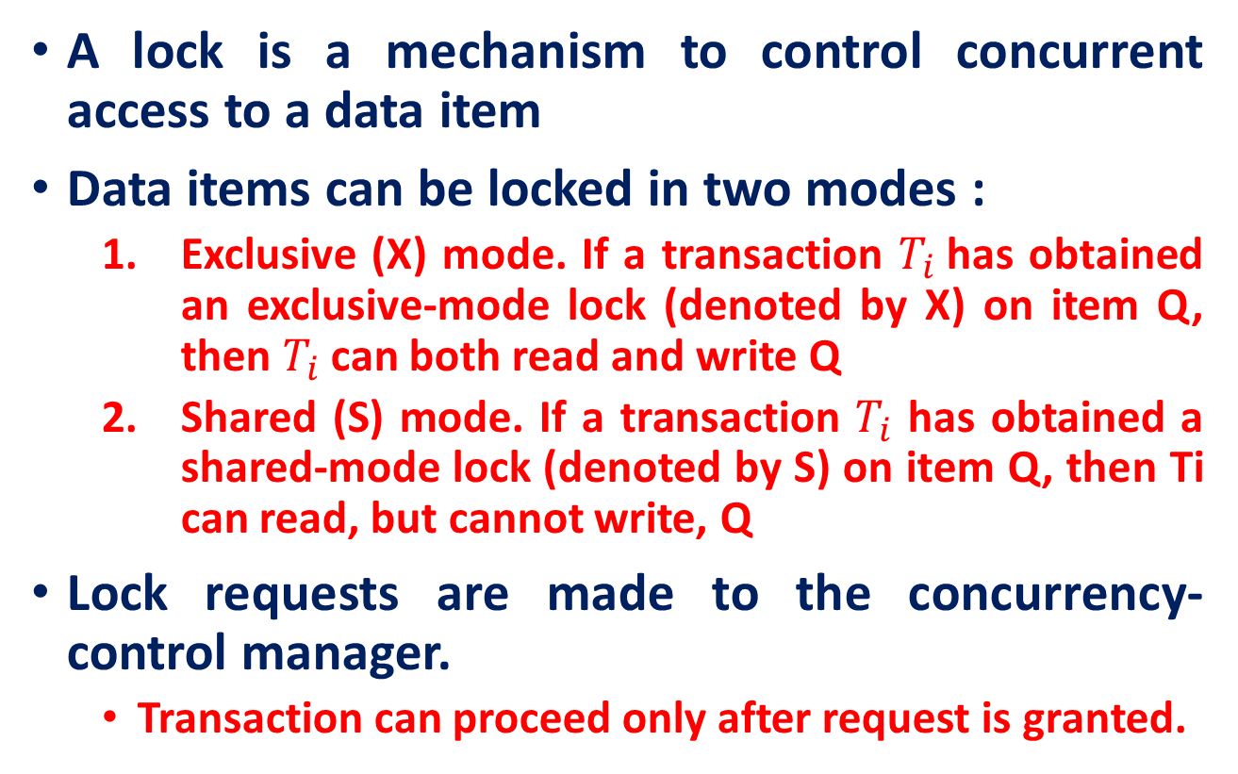
Lock-Based Protocols
A lock is a mechanism to control concurrent access to a data item
Data items can be locked in two modes :
Exclusive (X) mode. If a transaction $T_{i}$has obtained an exclusive-mode lock (denoted by X) on item Q, then $T_{i}$ can both read and write Q
Shared (S) mode. If a transaction $T_{i}$ has obtained a shared-mode lock (denoted by S) on item Q, then Ti can read, but cannot write, Q
Lock requests are made to the concurrency-control manager.
Transaction can proceed only after request is granted.

Slide 8
Lock-compatibility matrix
A transaction may be granted a lock on an item if the requested lock is compatible with locks already held on the item by other transactions
Any number of transactions can hold shared locks on an item,
but if any transaction holds an exclusive lock on the item no other transaction may hold any lock on the item.
If a lock cannot be granted, the requesting transaction is made to wait till all incompatible locks held by other transactions have been released. The lock is then granted.

Slide 9
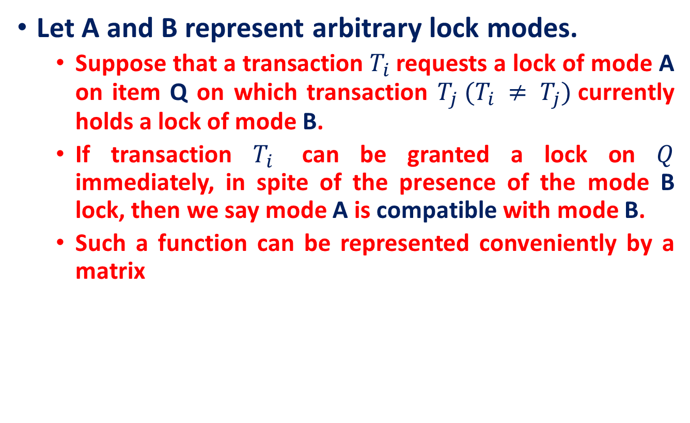
Lock-Based Protocols: compatibility function
Let A and B represent arbitrary lock modes.
Suppose that a transaction $T_{i}$requests a lock of mode A on item Q on which transaction $T_{j} (T_{i} ≠ T_{j})$currently holds a lock of mode B.
If transaction $T_{i}$ can be granted a lock on $Q$ immediately, in spite of the presence of the mode B lock, then we say mode A is compatible with mode B.
Such a function can be represented conveniently by a matrix

Slide 10
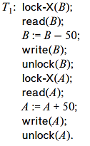
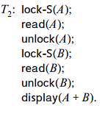
Lock-Based Protocol
Let A and B be two accounts that are accessed by transactions T1 and T2.
Transaction T1 transfers $50 from account B to account A.
Transaction T2 displays the total amount of money in accounts A and B—that is, the sum A + B

Slide 11
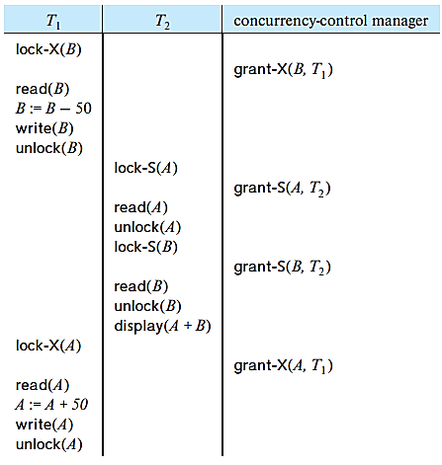
Lock-Based Protocol
Let A (100$) and B (200$) be two accounts that are accessed by transactions T1 and T2.
Transaction T1 transfers $50 from account B to account A.
Transaction T2 displays the total amount of money in accounts A and B—that is, the sum A + B

Slide 12
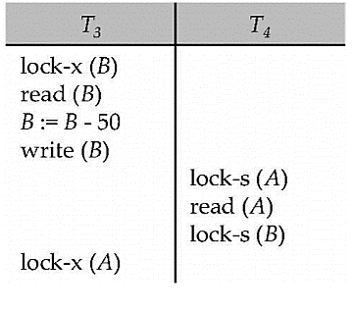
Pitfalls of Lock-Based Protocols
Neither T3 nor T4 can make progress — executing lock-S(B) causes T4 to wait for T3 to release its lock on B, while executing lock-X(A) causes T3 to wait for T4 to release its lock on A.
Such a situation is called a deadlock.
To handle a deadlock one of T3 or T4 must be rolled back, and its locks released.

Slide 13
Pitfalls of Lock-Based Protocols
Starvation is also possible if the concurrency control manager is badly designed. For example:
A transaction may be waiting for an X-lock on an item, while a sequence of other transactions request and are granted an S-lock on the same item.
The same transaction is repeatedly rolled back due to deadlocks.
Concurrency control managers can be designed to prevent starvation

Slide 14
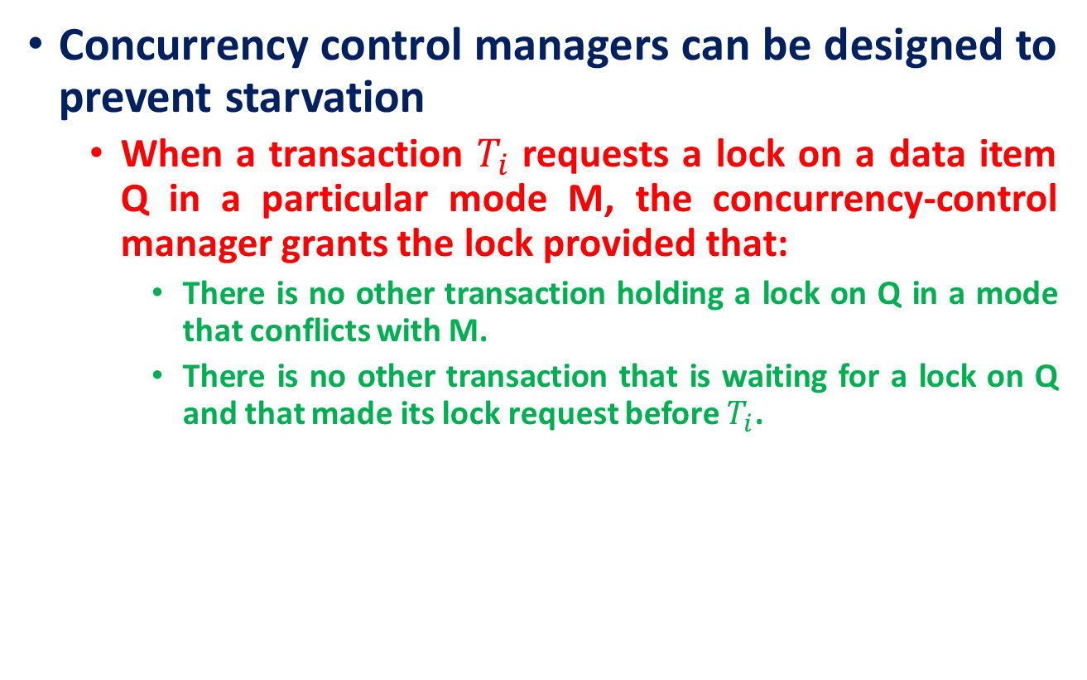
Pitfalls of Lock-Based Protocols
Concurrency control managers can be designed to prevent starvation
When a transaction $T_{i}$ requests a lock on a data item Q in a particular mode M, the concurrency-control manager grants the lock provided that:
There is no other transaction holding a lock on Q in a mode that conflicts with M.
There is no other transaction that is waiting for a lock on Q and that made its lock request before $T_{i}$.

Slide 15
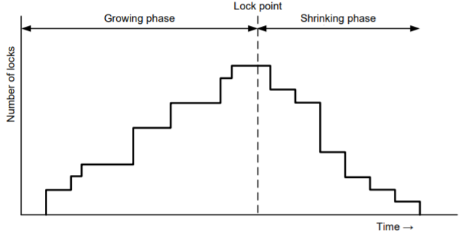
The Two-Phase Locking Protocol
This is a protocol which ensures conflict-serializable schedules.
Phase 1: Growing Phase
Transaction may obtain locks
Transaction may not release locks
Phase 2: Shrinking Phase
Transaction may release locks
Transaction may not obtain locks
The protocol assures serializability. It can be proved that the transactions can be serialized in the order of their lock points (i.e., the point where a transaction acquired its final lock).

Slide 16
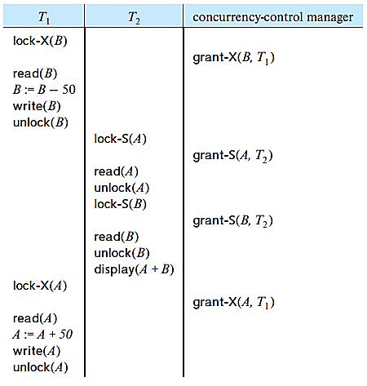
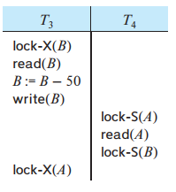
The Two-Phase Locking Protocol
T3 and T4 are two phase. On the other hand, transactions T1 and T2 are not two phase.

Slide 17
The Two-Phase Locking Protocol
Two-phase locking does not ensure freedom from deadlocks
Cascading roll-back is possible under two-phase locking. To avoid this, follow a modified protocol called strict two-phase locking.
Here a transaction must hold all its exclusive locks till it commits or aborts.
Rigorous two-phase locking is even stricter:
All locks are held till commit/abort. In this protocol transactions can be serialized in the order in which they commit.

Slide 18
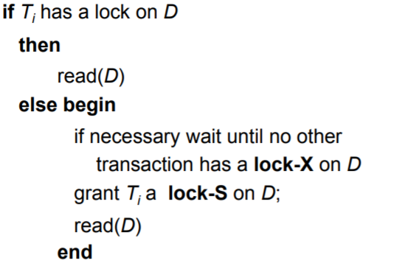

Automatic Acquisition of Locks
A transaction $T_{i}$ issues the standard read/write instruction, without explicit locking calls.
The operation read(D) is processed as:

Slide 19
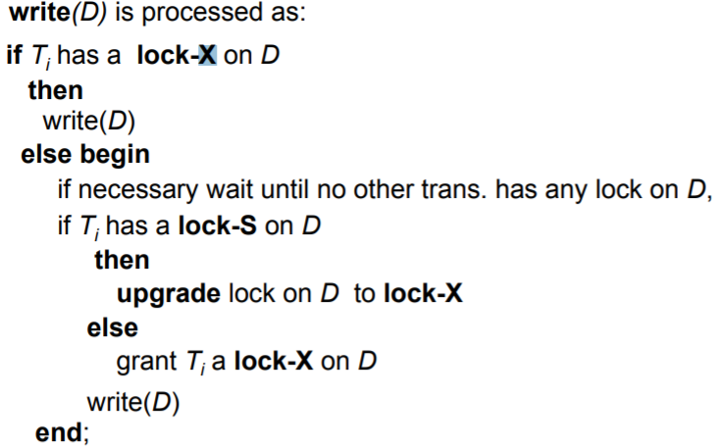

Automatic Acquisition of Locks
A transaction $T_{i}$ issues the standard read/write instruction, without explicit locking calls.
The operation write(D) is processed as:
All locks are released after commit or abort

Slide 20
Implementation of Locking
A lock manager can be implemented as a separate process to which transactions send lock and unlock requests
The lock manager replies to a lock request by sending a lock grant messages (or a message asking the transaction to roll back, in case of a deadlock)
The requesting transaction waits until its request is answered
The lock manager maintains a data-structure called a lock table to record granted locks and pending requests
The lock table is usually implemented as an in-memory hash table indexed on the name of the data item being locked

Slide 21
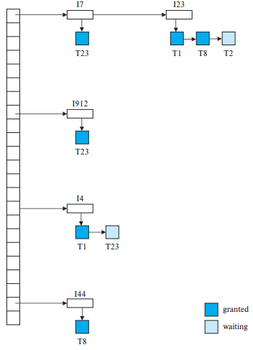
Lock Table
The table contains locks for five different data items, I4, I7, I23, I44, and I912.
The lock table uses overflow chaining
There is also a list of transactions that have been granted locks, or are waiting for locks, for each of the data items

Slide 22
Lock Table
The lock manager processes requests this way:
New request is added to the end of the queue of requests for the data item, and granted if it is compatible with all earlier locks
Unlock requests result in the request being deleted, and later requests are checked to see if they can now be granted
If transaction aborts, all waiting or granted requests of the transaction are deleted
lock manager may keep a list of locks held by each transaction, to implement this efficiently

Slide 23
The Two-Phase Locking Protocol
two-phase locking protocol is a blocking protocol that may limit the amount of concurrency that occurs in a schedule.
It may reduce the efficiency and increase the wait time of a transaction.

Slide 24
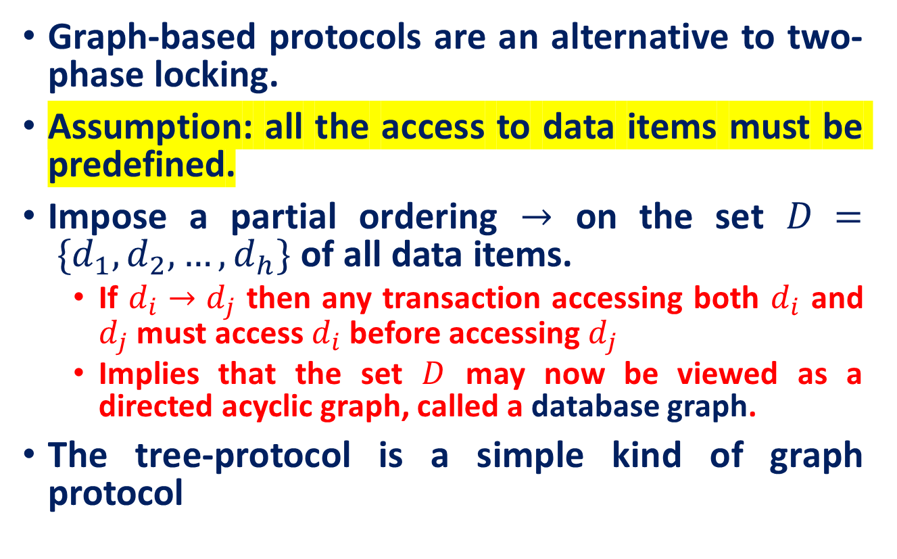
Graph-Based Protocols
Graph-based protocols are an alternative to two-phase locking.
Assumption: all the access to data items must be predefined.
Impose a partial ordering $→$ on the set $D = \{d_{1}, d_{2},…, d_{h}\}$of all data items.
If $d_{i}→d_{j}$ then any transaction accessing both $d_{i}$ and $d_{j}$ must access $d_{i}$ before accessing $d_{j}$
Implies that the set $D$ may now be viewed as a directed acyclic graph, called a database graph.
The tree-protocol is a simple kind of graph protocol

Slide 25
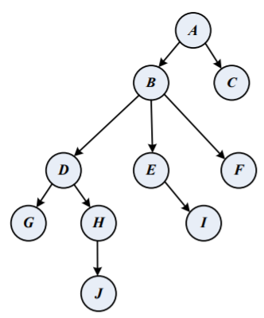
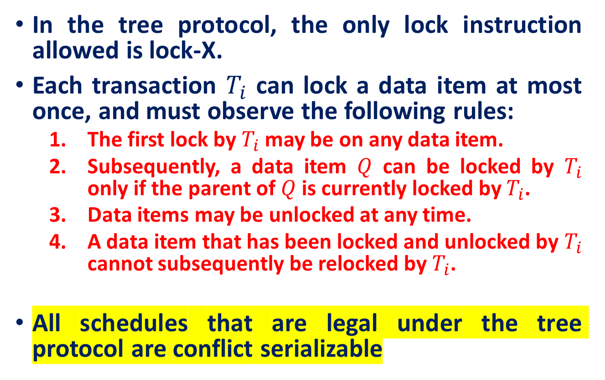
tree-protocol
In the tree protocol, the only lock instruction allowed is lock-X.
Each transaction $T_{i}$ can lock a data item at most once, and must observe the following rules:
The first lock by $T_{i}$ may be on any data item.
Subsequently, a data item $Q$ can be locked by $T_{i}$ only if the parent of $Q$ is currently locked by $T_{i}$.
Data items may be unlocked at any time.
A data item that has been locked and unlocked by $T_{i}$ cannot subsequently be relocked by $T_{i}$.
All schedules that are legal under the tree protocol are conflict serializable

Slide 26

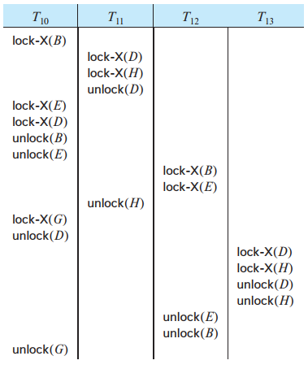










tree-protocol
$$T_{12}$$
$$T_{10}$$
$$T_{11}$$
$$T_{13}$$
$$T_{10}$$
$$T_{10}$$
$$T_{12}$$
$$T_{10}$$
$$T_{13}$$
$$T_{11}$$
Serializable schedule under the tree protocol

Slide 27
tree-protocol
The tree protocol ensures serializability as well as freedom from deadlock.
Unlocking may occur earlier in the tree-locking protocol than in the two-phase locking protocol.
shorter waiting times, and increase in concurrency
protocol is deadlock-free, no rollbacks are required
Drawbacks
Protocol does not guarantee recoverability or cascade freedom
Need to introduce commit dependencies to ensure recoverability
Transactions may have to lock data items that they do not access.

Slide 28

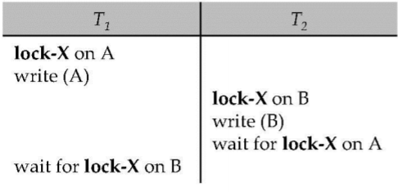
Deadlock Handling
Consider the following two transactions:
Schedule with deadlock

Slide 29
Deadlock Handling
System is deadlocked if there is a set of transactions such that every transaction in the set is waiting for another transaction in the set.
Deadlock prevention protocols ensure that the system will never enter into a deadlock state.
Some prevention strategies :
Require that each transaction locks all its data items before it begins execution (predeclaration).
Impose partial ordering of all data items and require that a transaction can lock data items only in the order specified by the partial order (graph-based protocol)

Slide 30
More Deadlock Prevention Strategies
Following schemes use transaction timestamps for the sake of deadlock prevention alone.
wait-die scheme — non-preemptive
older transaction may wait for younger one to release data item. Younger transactions never wait for older ones; they are rolle back instead.
For example, suppose that transactions T14, T15, and T16 have timestamps 5, 10, and 15, respectively.
If T14 requests a data item held by T15, then T14 will wait.
If T16 requests a data item held by T15, then T16 will be rolled back.

Slide 31
More Deadlock Prevention Strategies
Following schemes use transaction timestamps for the sake of deadlock prevention alone.
wound–wait scheme — preemptive
older transaction wounds (= forces rollback) of younger transaction instead of waiting for it. Younger transactions may wait for older ones.
For example, suppose that transactions T14, T15, and T16 have timestamps 5, 10, and 15, respectively.
If T14 requests a data item held by T15, then the data item will be preempted from T15, and T15 will be rolled back. .
If T16 requests a data item held by T15, then T16 will wait.

Slide 32
More Deadlock Prevention Strategies
Timeout-Based Schemes:
a transaction waits for a lock only for a specified amount of time.
After that, the wait times out and the transaction is rolled back thus deadlocks are not possible
simple to implement; but starvation is possible. Also difficult to determine good value of the timeout interval.

Slide 33
Deadlock Detection and Recovery
If a system does not employ some protocol that ensures deadlock freedom, then a detection and recovery scheme must be used.
An algorithm that examines the state of the system is invoked periodically to determine whether a deadlock has occurred.
If one has, then the system must attempt to recover from the deadlock.

Slide 34
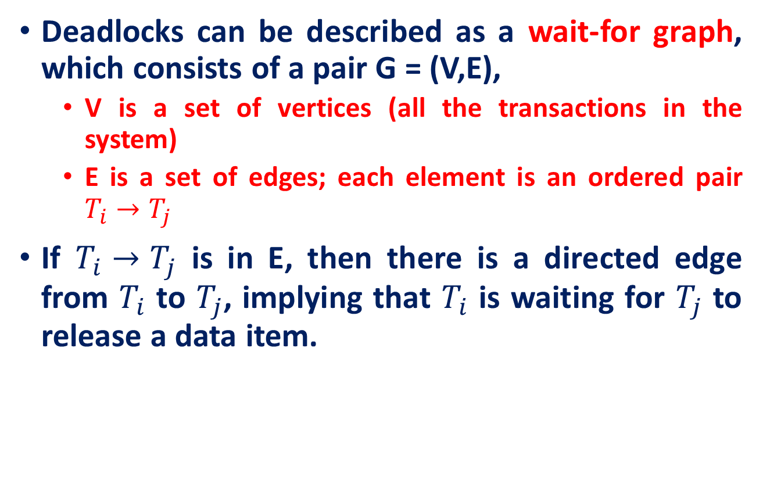
Deadlock Detection
Deadlocks can be described as a wait-for graph, which consists of a pair G = (V,E),
V is a set of vertices (all the transactions in the system)
E is a set of edges; each element is an ordered pair $T_{i}→T_{j}$
If $T_{i}→T_{j}$ is in E, then there is a directed edge from $T_{i}$ to $T_{j}$, implying that $T_{i}$ is waiting for $T_{j}$ to release a data item.

Slide 35
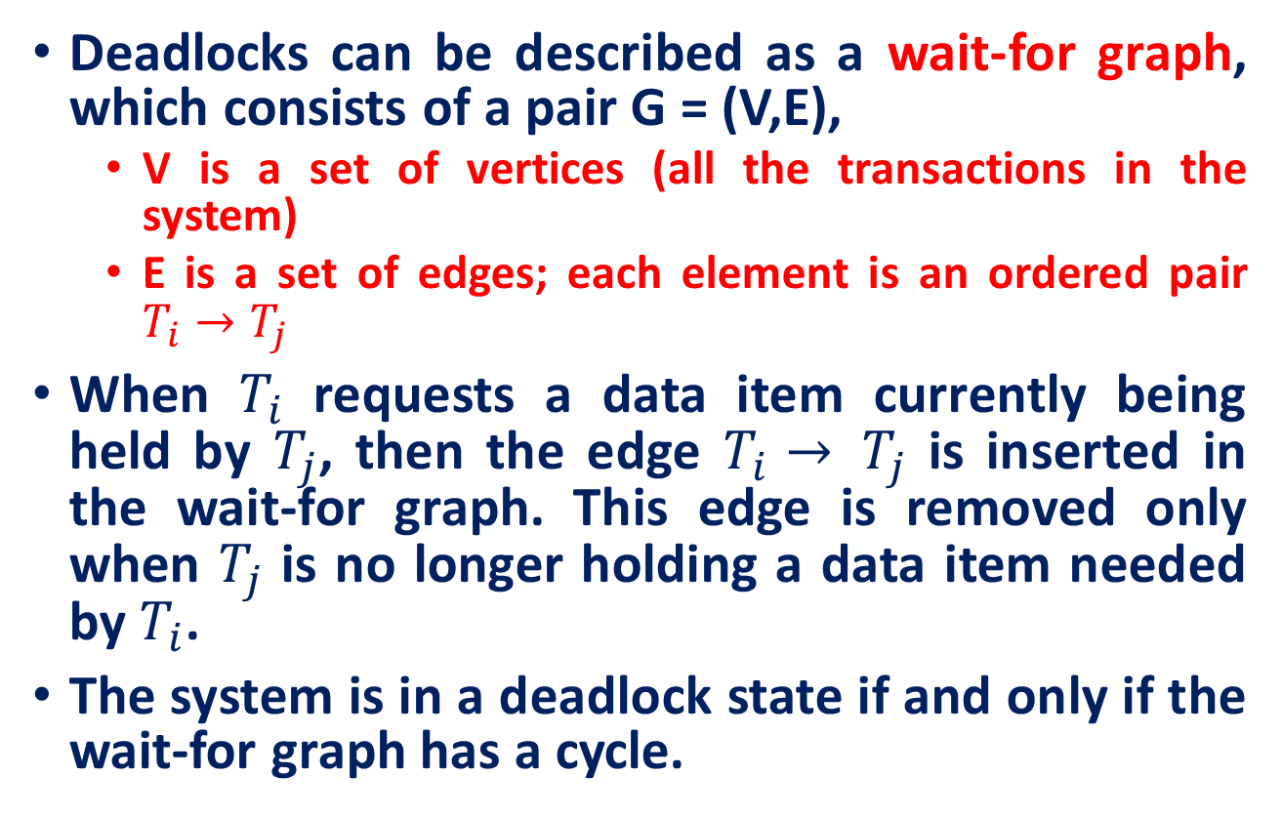
Deadlock Detection
Deadlocks can be described as a wait-for graph, which consists of a pair G = (V,E),
V is a set of vertices (all the transactions in the system)
E is a set of edges; each element is an ordered pair $T_{i}→T_{j}$
When $T_{i}$ requests a data item currently being held by $T_{j}$, then the edge $T_{i}→ T_{j}$ is inserted in the wait-for graph. This edge is removed only when $T_{j}$ is no longer holding a data item needed by $T_{i}$.
The system is in a deadlock state if and only if the wait-for graph has a cycle.

Slide 36
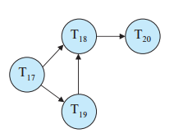
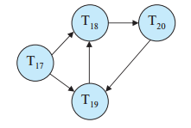
Deadlock Detection
Transaction T17 is waiting for transactions T18 and T19.
Transaction T19 is waiting for transaction T18.
Transaction T18 is waiting for transaction T20.
Suppose now that transaction T20 is requesting an item held by T19.

Slide 37
Deadlock Recovery
When deadlock is detected :
Some transaction will have to rolled back (made a victim) to break deadlock. Select that transaction as victim that will incur minimum cost.
Rollback – determine how far to roll back transaction
Total rollback: Abort the transaction and then restart it.
More effective to roll back transaction only as far as necessary to break deadlock.
Starvation happens if same transaction is always chosen as victim. Include the number of rollbacks in the cost factor to avoid starvation

Slide 38
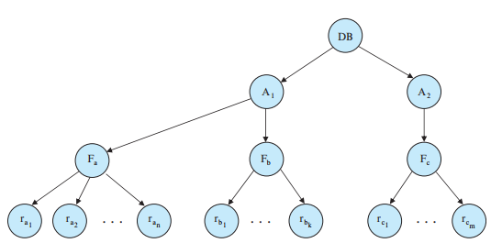
Multiple Granularity
So far, we have used each individual data item as the unit on which synchronization is performed.
However, in some situation we have to group several data items, and to treat them as one individual synchronization unit.

Slide 39
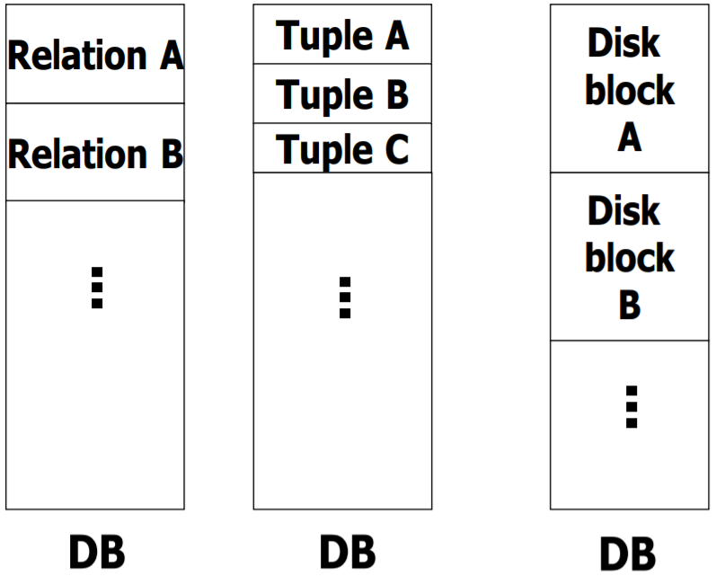
What are the Objects We Lock?
Database elements can be tuples, blocks or entire relations.

Slide 40
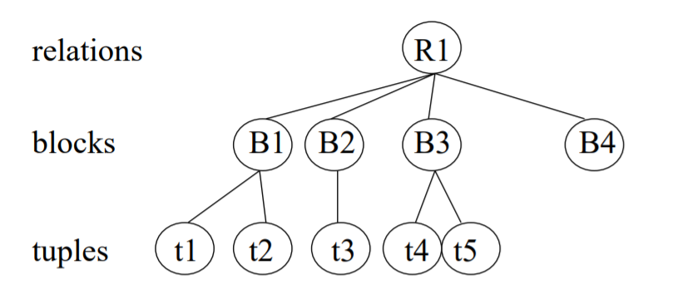
Locks With Multiple Granularity Locks With Multiple Granularity
Locking works in any case, but should we choose large objects or small objects? At which level of granularity shall we lock?
There is a trade-off: the lower the level of granularity, the more concurrency, but the more locks and the higher the locking overhead.
Best trade-off depends on application: e.g., lock blocks or tuples in bank database, and entire documents in document database.

Slide 41
Multiple Granularity
Database elements are organized in a hierarchy and can be represented graphically as a tree.
When a transaction locks a node in the tree explicitly, it implicitly locks all the node's descendants in the same mode.
Granularity of locking (level in tree where locking is done):
fine granularity (lower in tree): high concurrency, high locking overhead
coarse granularity (higher in tree): low locking overhead, low concurrency

Slide 42
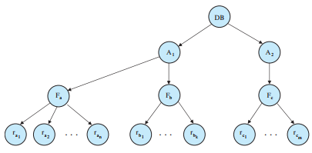





Multiple Granularity
If transaction $T_{i}$ gets an explicit lock on file $F_{c}$, in exclusive mode, then it has an implicit lock in exclusive mode on all the records belonging to that file.
It does not need to lock the individual records of $F_{c}$ explicitly.
$$T_{i}:X(F_{C})$$
$$T_{i}:X(r_{C_{1}})$$
$$T_{i}:X(r_{C_{n}})$$
Case I: If $T_{i}$ is requesting for a lock over $t_{2}$, then you have to make sure that non of in antecedents are locked by any other transactions.
Case II: : If $T_{i}$ is requesting for a lock over B1, then you have to make sure that non of in descendent are locked by any other transactions.
Problem: How does system determines, whether the root can be locked?
Solution: search the entire tree
This solution, however, defeats the whole purpose of the multiple-granularity locking scheme.

Slide 43
Multiple Granularity
A more efficient way to gain this knowledge is to introduce a new class of lock modes, called intention lock modes.
If a node is locked in an intention mode, explicit locking is done at a lower level of the tree (that is, at a finer granularity).
Intention locks are put on all the ancestors of a node before that node is locked explicitly.
Thus, a transaction does not need to search the entire tree to determine whether it can lock a node successfully.
A transaction wishing to lock a node—say, Q—must traverse a path in the tree from the root to Q. While traversing the tree, the transaction locks the various nodes in an intention mode.

Slide 44
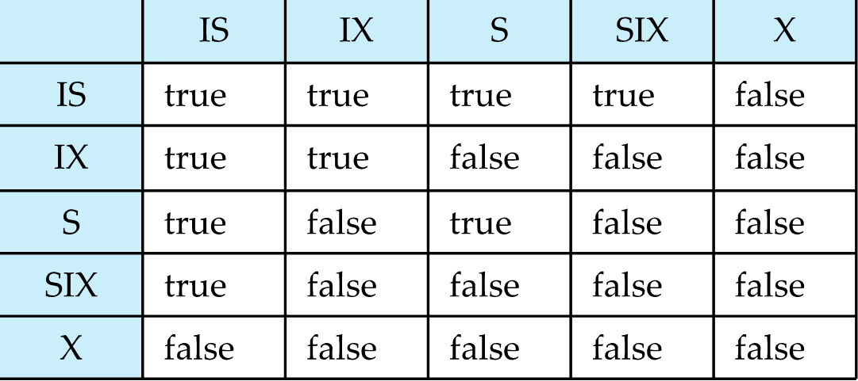
Intention Lock Modes
In addition to S and X lock modes, there are three additional lock modes with multiple granularity:
Intention-shared (IS): at lease on descendants has a s-lock
Intention-exclusive (IX): at least on descendants has a x-lock
Shared-intention-exclusive (SIX): The node itself is locked in an s-mode and at least on descendants has a x-lock
IS
S

Slide 45
Multiple Granularity Locking Scheme
Transaction T_{i} can lock a node Q, using the following rules:
The lock compatibility matrix must be observed.
The root of the tree must be locked first, and may be locked in any mode.
A node Q can be locked by T_{i} in S or IS mode only if the parent of Q is currently locked by T_{i} in either IX or IS mode.
A node Q can be locked by T_{i} in X, SIX, or IX mode only if the parent of Q is currently locked by T_{i} in either IX or SIX mode.
T_{i} can lock a node only if it has not previously unlocked any node (that is, T_{i} is two-phase).
T_{i} can unlock a node Q only if none of the children of Q are currently locked by T_{i}.
Observe that locks are acquired in root-to-leaf order, whereas they are released in leaf-to-root order.

Slide 46
Timestamp-Based Protocols
Each transaction is issued a timestamp when it enters the system. If an old transaction T_{i} has time-stamp TS(T_{i}), a new transaction T_{j} is assigned time-stamp TS(T_{j}) such that TS(T_{i}) <TS(T_{j}).
The protocol manages concurrent execution such that the time-stamps determine the serializability order.
In order to assure such behavior, the protocol maintains for each data Q two timestamp values:
W-timestamp(Q) is the largest time-stamp of any transaction that executed write(Q) successfully.
R-timestamp(Q) is the largest time-stamp of any transaction that executed read(Q) successfully.

Slide 47
Timestamp-Based Protocols
The timestamp ordering protocol ensures that any conflicting read and write operations are executed in timestamp order.
Suppose a transaction T_{i} issues a read(Q)
If TS(T_{i}) < W-timestamp(Q), then T_{i} needs to read a value of Q that was already overwritten.
Hence, the read operation is rejected, and T_{i} is rolled back.
If TS(T_{i}) ≥ W-timestamp(Q), then the read operation is executed, and R-timestamp(Q) is set to max(R-timestamp(Q), TS(T_{i})).

Slide 48
Timestamp-Based Protocols
Suppose that transaction T_{i} issues write(Q).
If TS(T_{i}) < R-timestamp(Q), then the value of Q that T_{i} is producing was needed previously, and the system assumed that that value would never be produced.
Hence, the write operation is rejected, and T_{i} is rolled back.
If TS(T_{i}) < W-timestamp(Q), then T_{i} is attempting to write an obsolete value of Q.
Hence, this write operation is rejected, and T_{i} is rolled back.
Otherwise, the write operation is executed, and W-timestamp(Q) is set to TS(T_{i}).

Slide 49
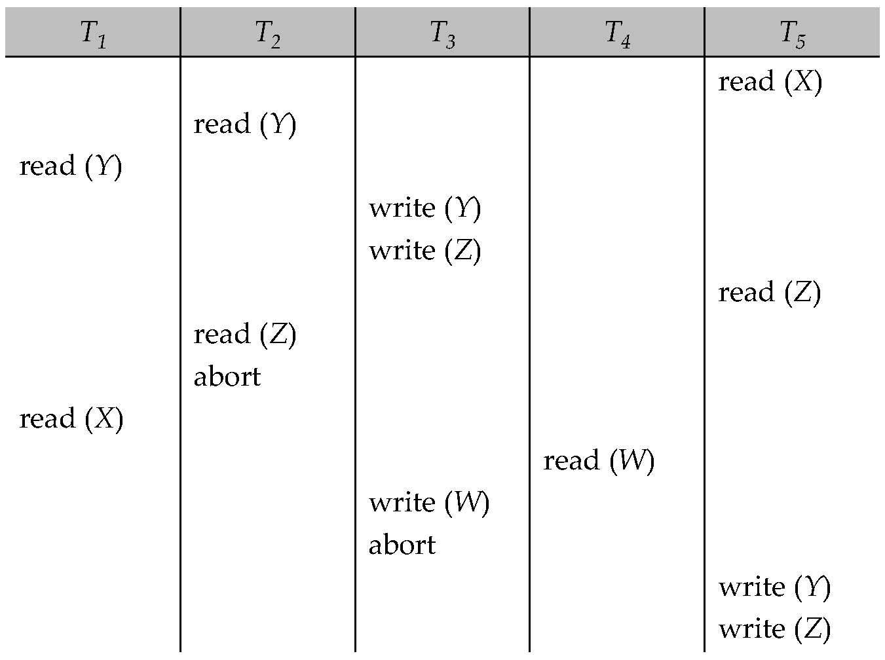
Example Use of the Protocol
A partial schedule for several data items for transactions with timestamps 1, 2, 3, 4, 5

Slide 50
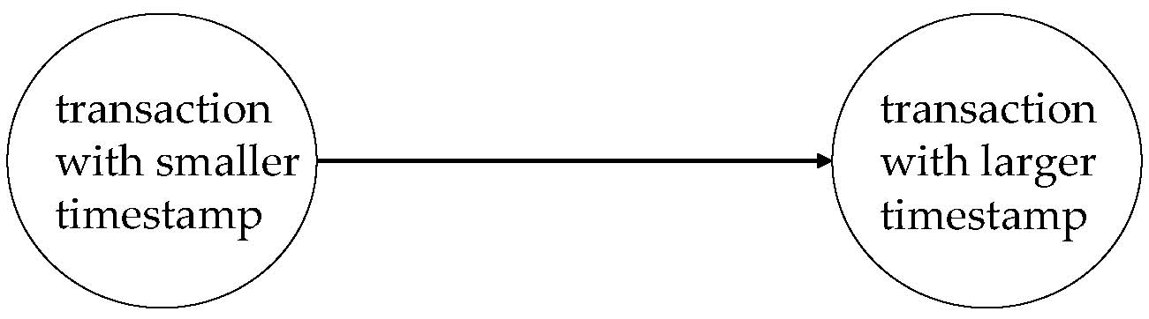
Correctness of Timestamp-Ordering Protocol
The timestamp-ordering protocol guarantees serializability since all the arcs in the precedence graph are of the form:
Thus, there will be no cycles in the precedence graph
Timestamp protocol ensures freedom from deadlock as no transaction ever waits.
But the schedule may not be cascade-free, and may not even be recoverable.

Slide 51
Recoverability and Cascade Freedom
Problem with timestamp-ordering protocol:
Suppose T_{i} aborts, but T_{j} has read a data item written by T_{i}
Then T_{j} must abort; if T_{j} had been allowed to commit earlier, the schedule is not recoverable.
Further, any transaction that has read a data item written by T_{j} must abort
This can lead to cascading rollback --- that is, a chain of rollbacks
Solution 1:
A transaction is structured such that its writes are all performed at the end of its processing
All writes of a transaction form an atomic action; no transaction may execute while a transaction is being written
A transaction that aborts is restarted with a new timestamp
Solution 2: Limited form of locking: wait for data to be committed before reading it
Solution 3: Use commit dependencies to ensure recoverability

Slide 52
Further Reading
Thomas’ Write Rule
Validation-Based Protocol
Multiversion Schemes
Snapshot Isolation

Slide 53
References
Abraham Silberschatz, Henry F. Korth, and S. Sudarshan, Database System Concepts, 7/e
Adhsakkdi Y, Raghuram Krishnan and Johannes Gehrke, Database Management Systems, 3/e, TMH, 2007.
Some of the figures and Examples are taken from various online sources.

